Slide 1
Between numbers
Task A: Finding numbers between two integers or decimals
Write down at least 3 decimals between the following pairs of numbers.
7 and 10 e.g. 8.25, 9.68, 7.0012
3 and 5 e.g. 3.845, 4.021, 4.998
10 and 11 e.g. 10.0098, 10.9895, 10.87
12.3 and 12.4 e.g. 12.354, 12.30009, 12.38764
2) What digit is covered in each of the following?
The arrow is pointing to the halfway point.
0.7
0.75
0.8
9.25
10.95
12.65
2.78
2.88
2.98
4.62
4.74
4.86
5.23
5.55
5.87
11.08
12.665
14.25
6.02
6.195
6.37
0.0054
0.0367
0.068

Slide 2


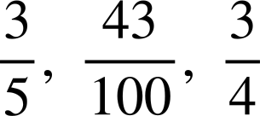

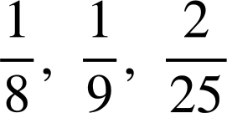


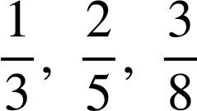


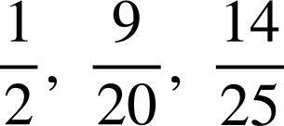
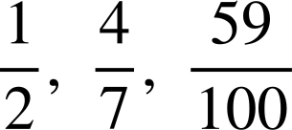










Between numbers
Task B: Finding numbers between two proper fractions
Choose a fraction that is between:
a)
and
b)
0
and
c)
and
d)
and
e)
and
2) Find the fraction that is halfway between:
a)
and
b)
and
c)
and
d)
and
e)
and
Mathematics in Education and Industry
v2.2

